Slide 1
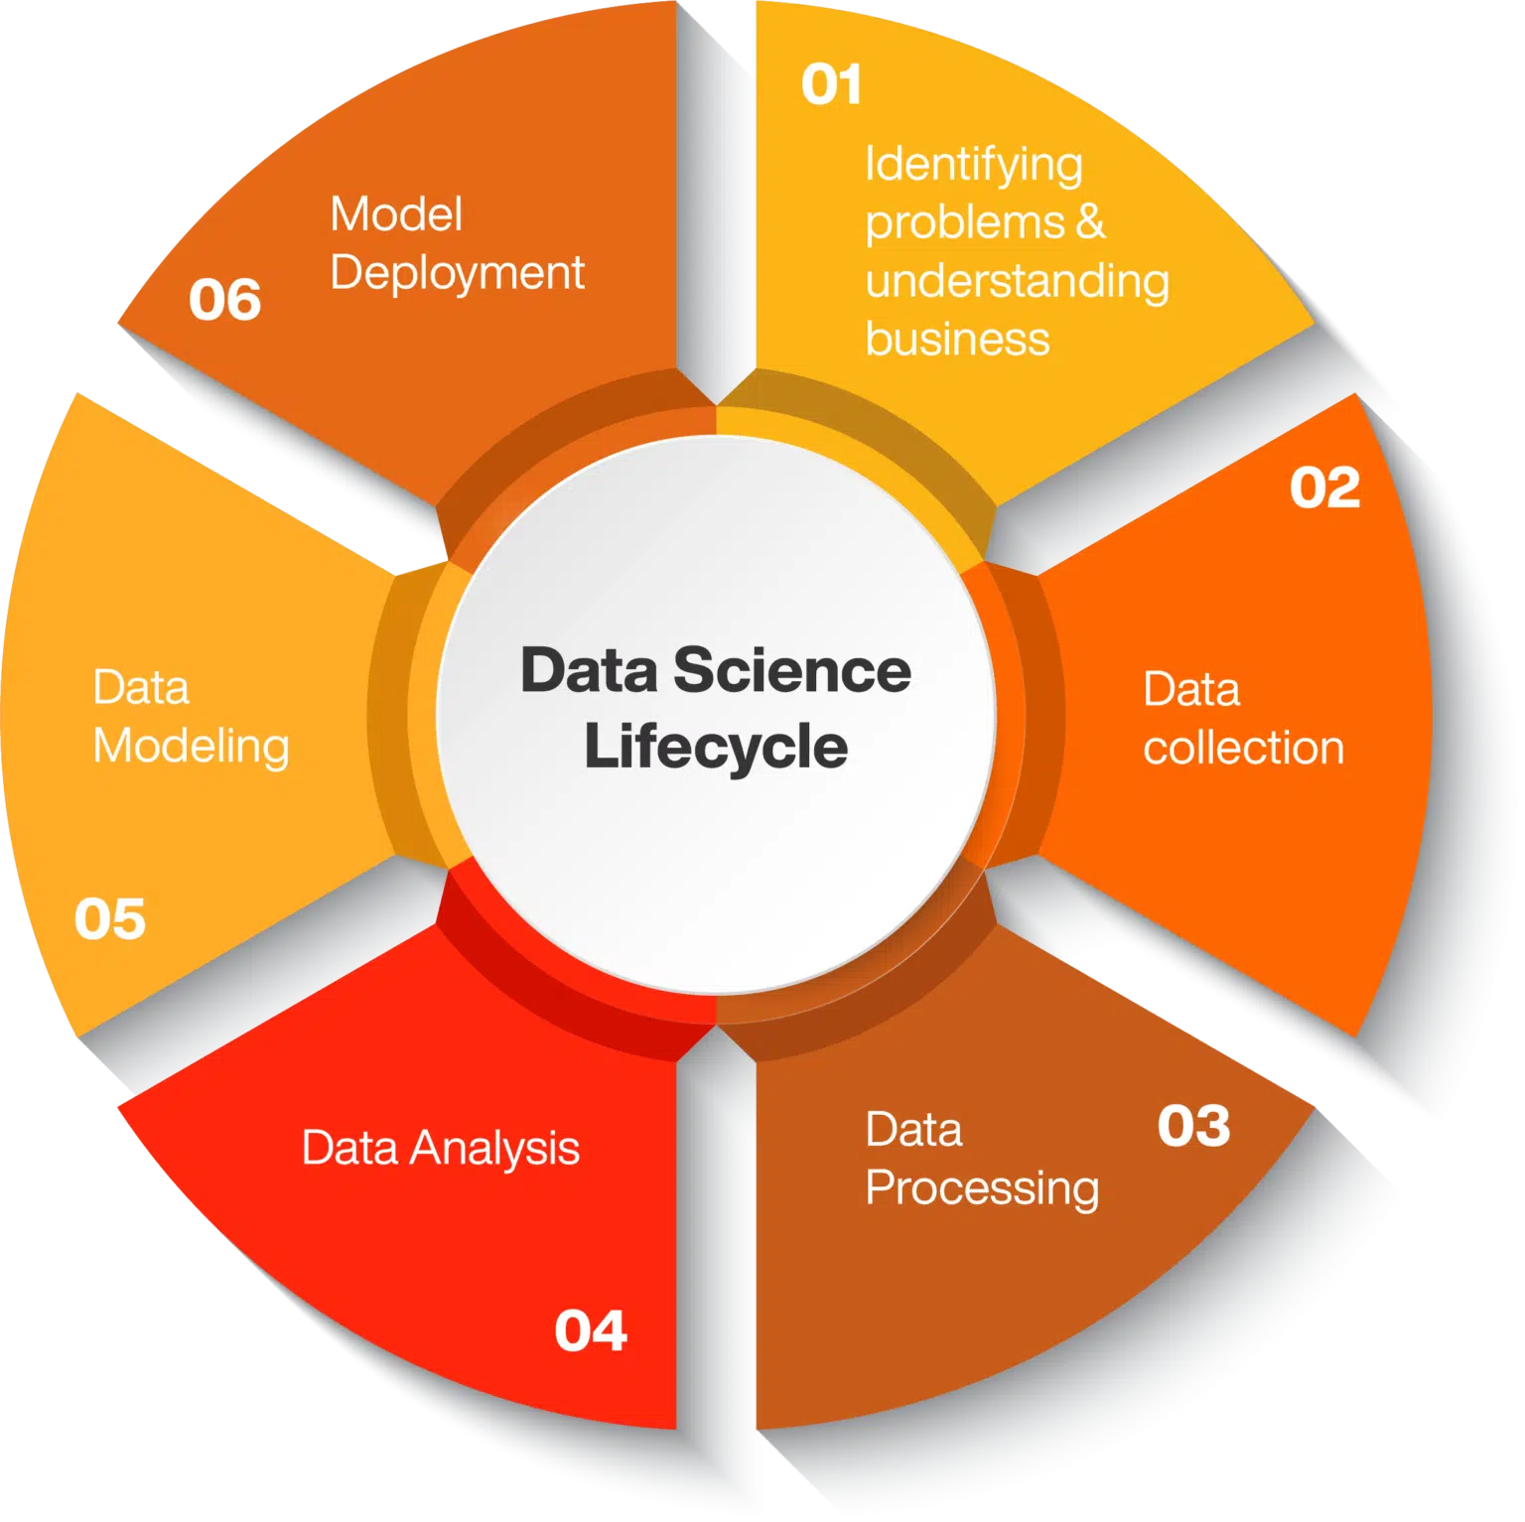
BaNKRUPTCY Prediction GROUP -2 P - 345
Presented By:
Anup Prasad
Akash Sultane
Gaurish Bhalkede
Manish Chaudhari
Vaishak Harshan

Slide 2
Project Objective:
The objective of this project is to develop a predictive classification model that assesses the probability of a business going bankrupt based on six key features.
The data file contains 7 features about 250 companies
The data set includes the following risk factors:
Industrial risk: 0 =low risk, 0.5=medium risk, 1=high risk.
Management risk: 0=low risk, 0.5=medium risk, 1=high risk.
financial flexibility: 0=low flexibility, 0.5=medium flexibility, 1=high flexibility.
credibility: 0=low credibility, 0.5=medium credibility, 1=high credibility.
competitiveness: 0=low competitiveness, 0.5=medium competitiveness, 1=high competitiveness.
Operating risk: 0=low risk, 0.5=medium risk, 1=high risk.

Slide 3
Procedure Followed
The delineation of the project's progression may be articulated through the subsequent procedural phases.
Data Pre-Processing
Exploratory Data Analysis
Feature Engineering
Model Building & Evaluation
Model Selection
Deployment

Slide 4

DATA
PRE - PROCESSING

Slide 5
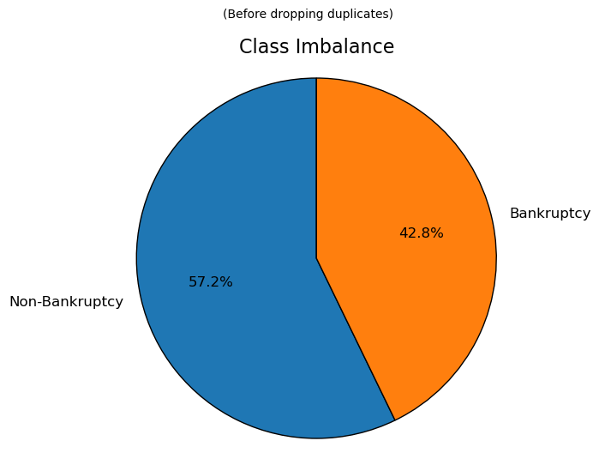
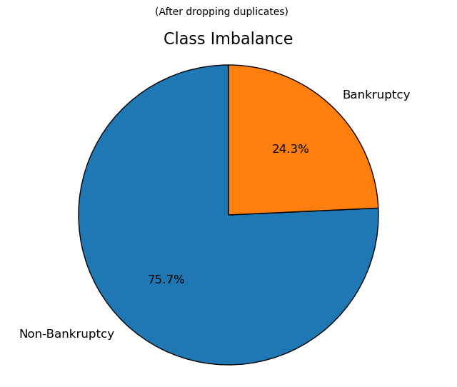
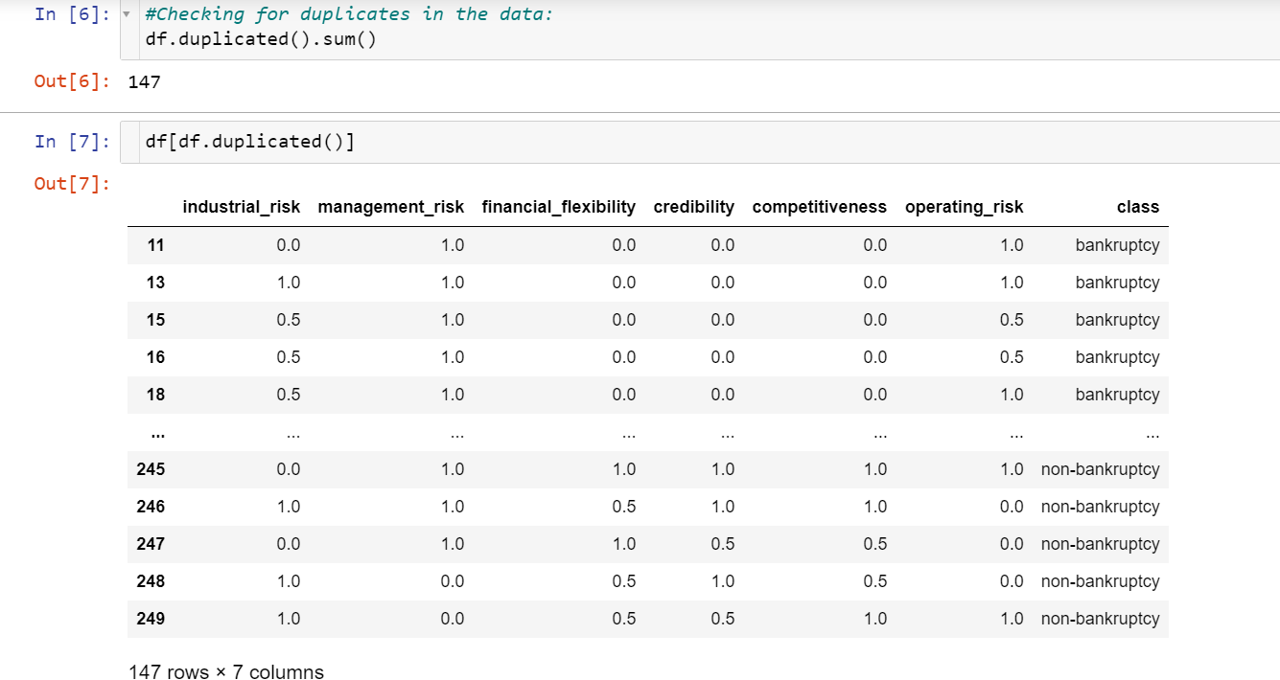
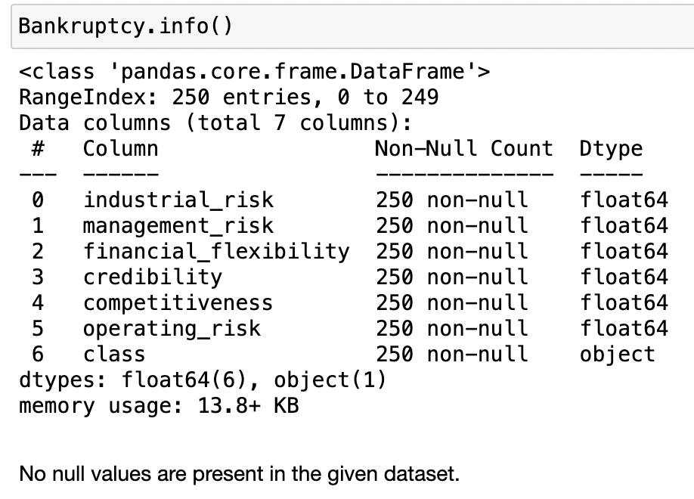
Data Observations:
All features are categorical.
Out of 250 entries, 147 are duplicates.
Class imbalance increased after deleting duplicates.

Slide 6

EXPLORATORY
DATA
ANALYSIS

Slide 7
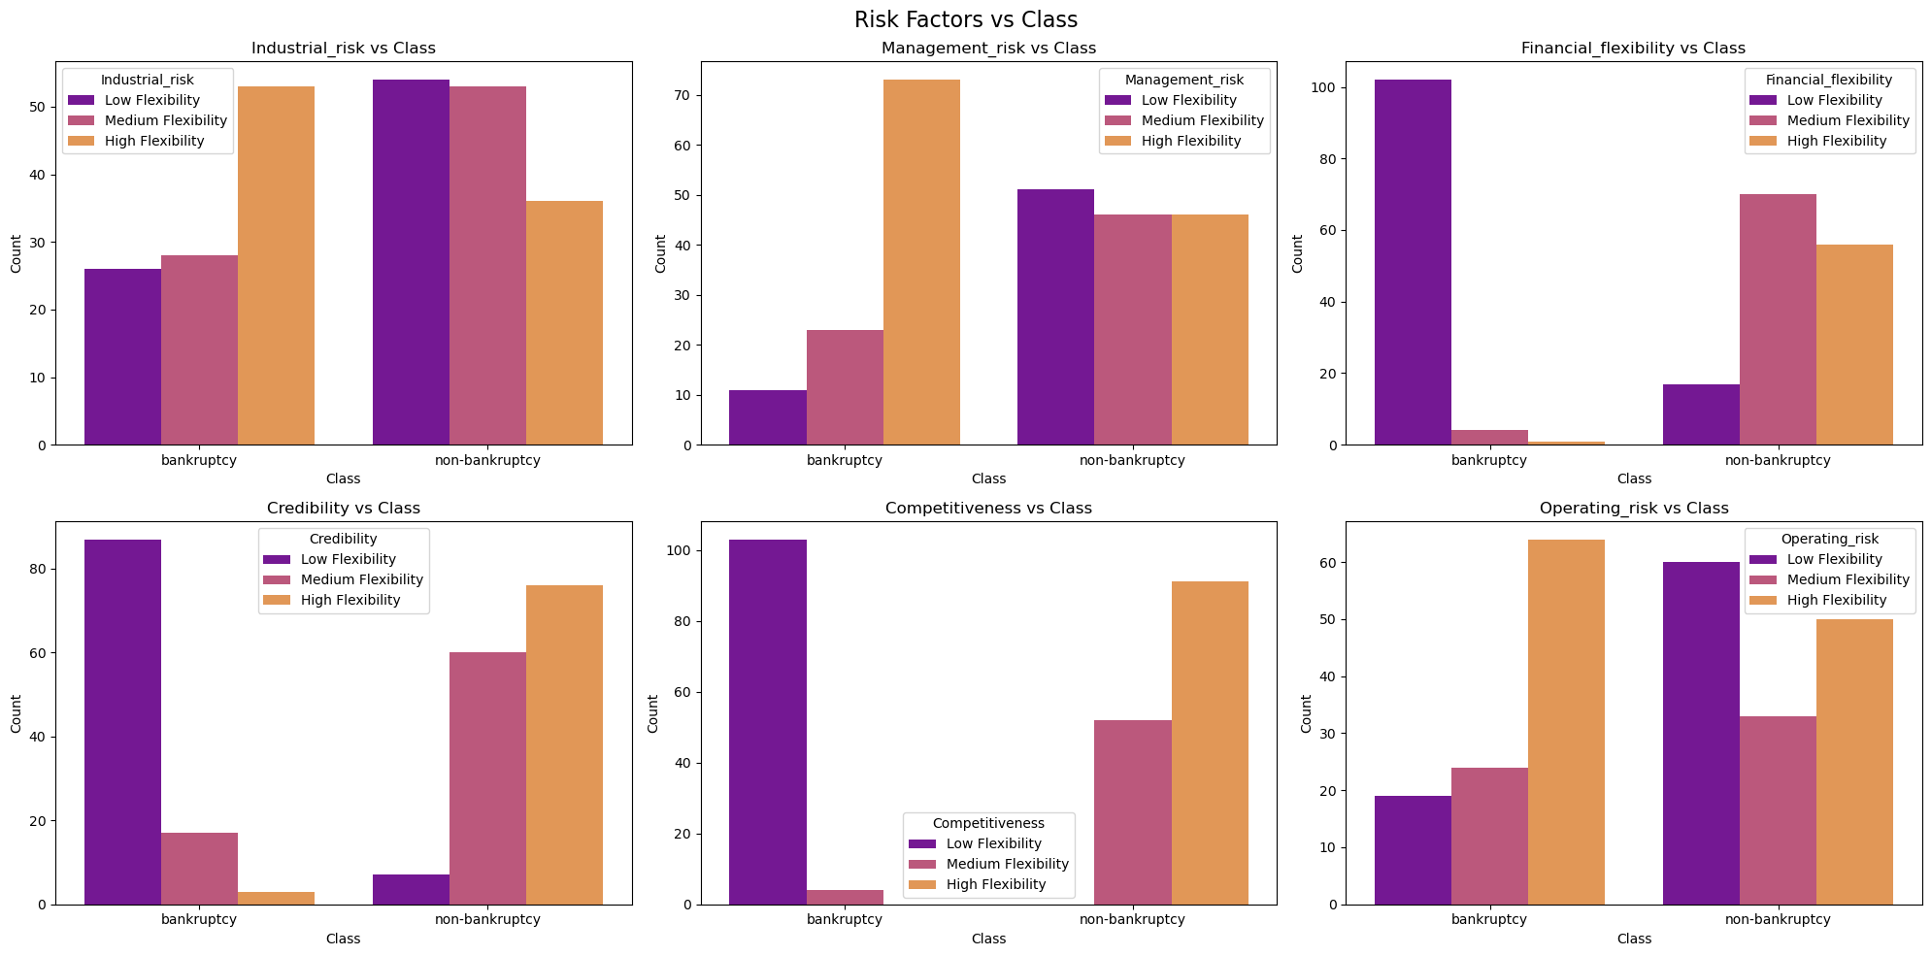
Relationship between different risk factors and the class (bankruptcy or non-bankruptcy) :

Slide 8
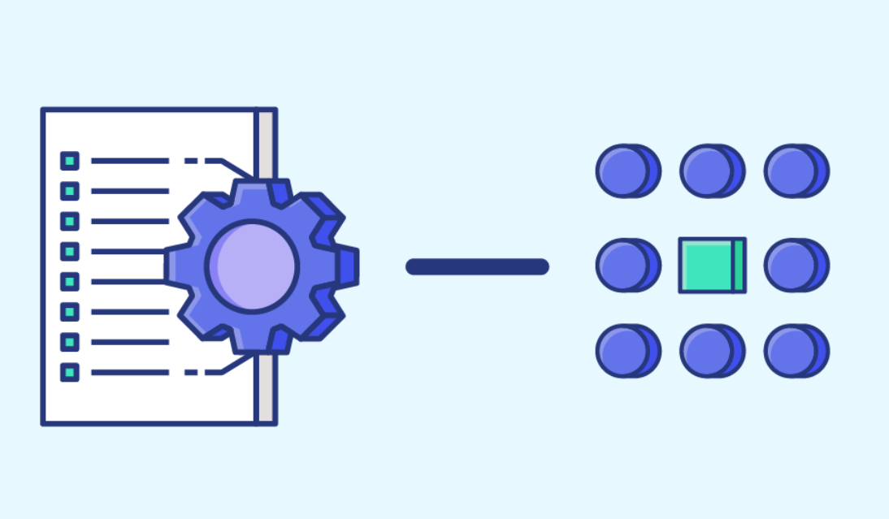
FEATURE ENGINEERING

Slide 9
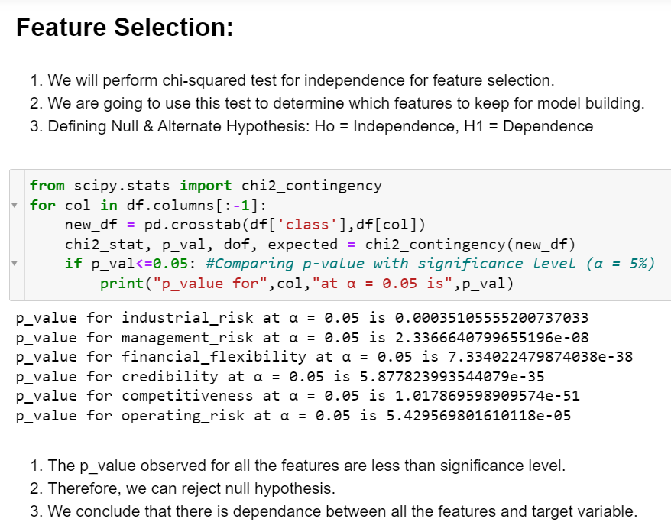

Slide 10
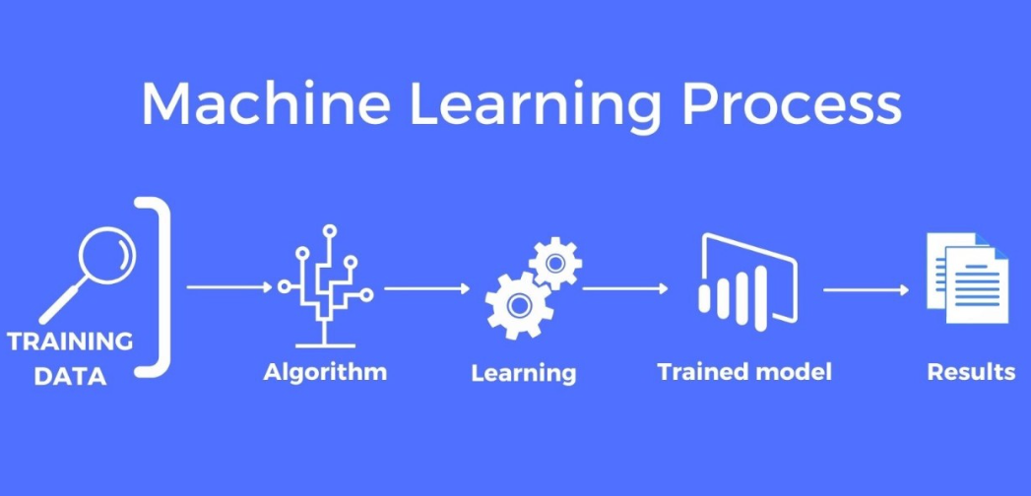
DATA MODELING

Slide 11
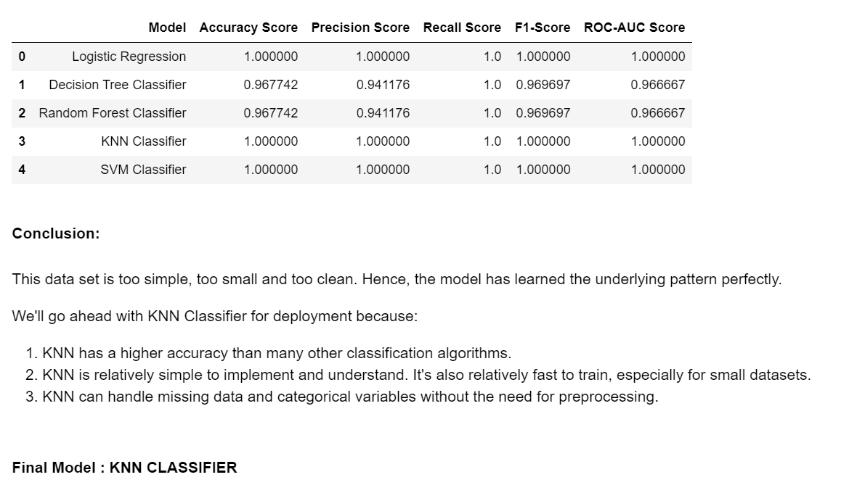

Slide 12
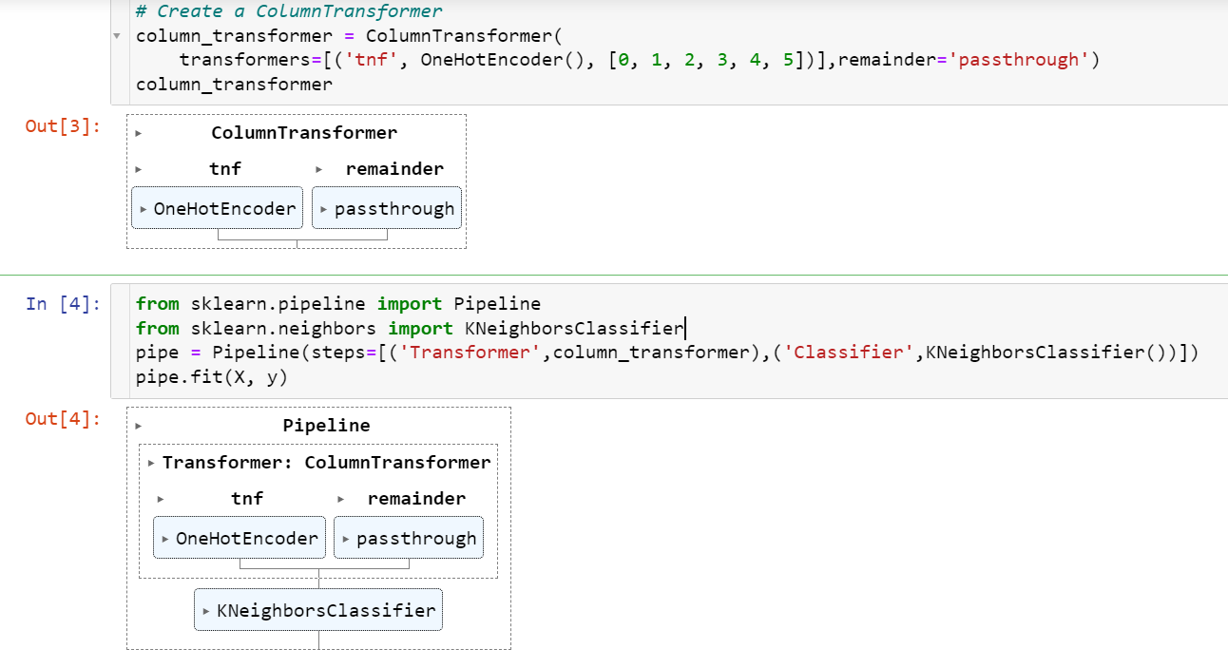
Final Model:

Slide 13

MODEL DEPLOYMENT

Slide 14
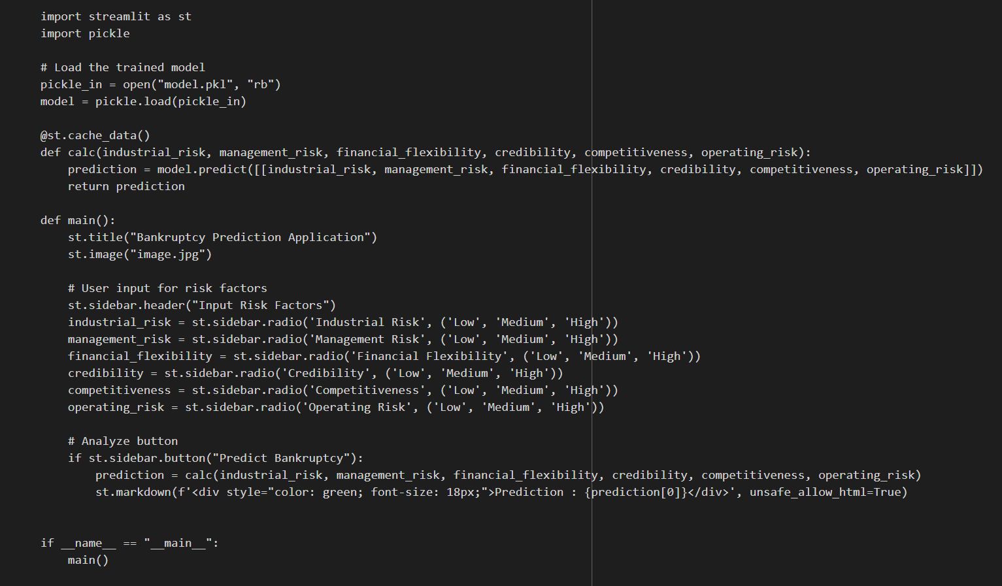
Web Application Design

Slide 15
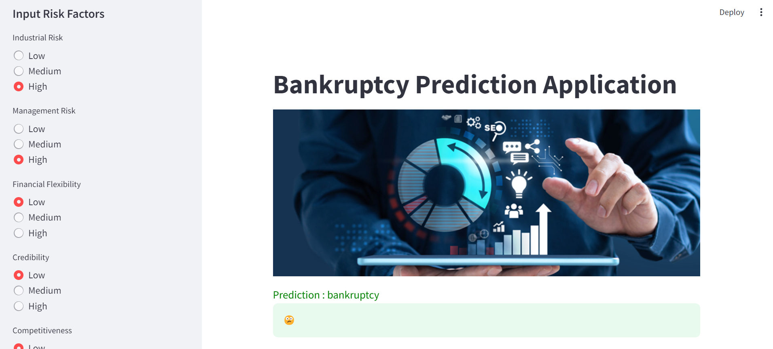
Web Application:

Slide 16
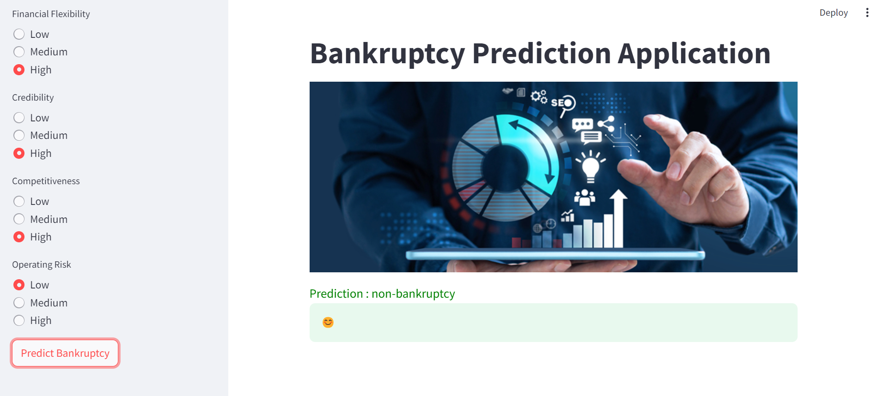
Web Application:

Slide 17
We created an accurate machine learning model and deployed it as a web application using streamlit
THANK YOU

